Slide 1


Construction of
ISTs In Bubble-Sort Networks
Scalable Construction and Parallelization using MPI, OpenMP, and METIS
Hafsa Imtiaz (22i-0959)
Areen Zainab (22i-1115)
Areeba Riaz (22i-1244)
Parallel & Distributed Computing

Slide 2


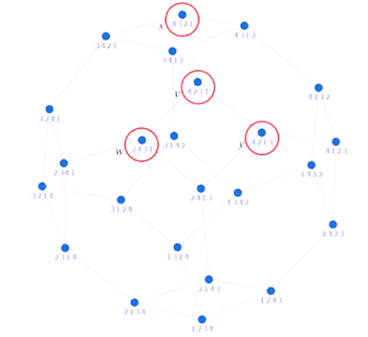
Introduction to Bubble-Sort Networks
A comparison network that sorts elements using adjacent swaps is similar to the bubble sort algorithm.
A bubble-sort network (Bn) is a graph where:
Nodes = all permutations of [1, 2, ..., n]
Edges = swap adjacent elements (like bubble sort)
It is regular and symmetric.
Bubble-Sort Network

Slide 3
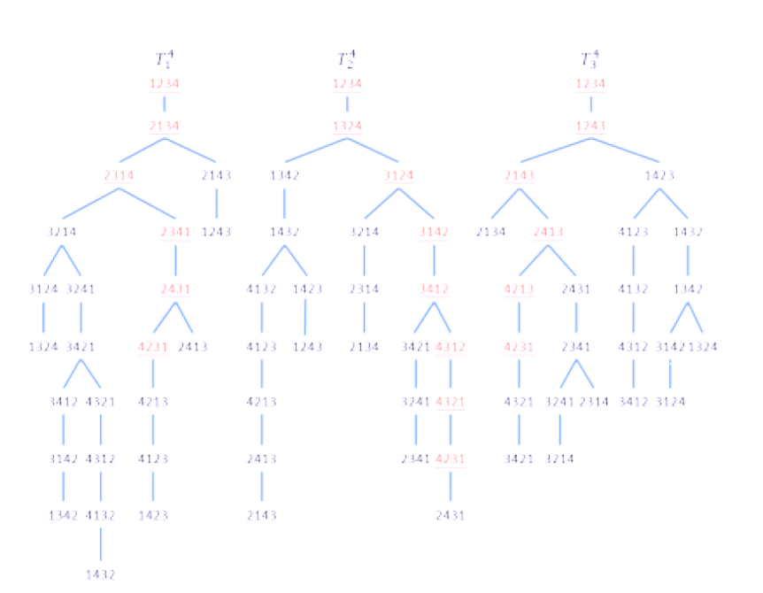
Independent Spanning Trees - Core Concepts
A collection of spanning trees rooted at the same vertex with no shared edges
A network with n nodes will have: n! ISTs.
An IST must span all the nodes, but no two istS can share any edges.
No single edge failure can simultaneously disconnect a node from the root in all trees.

Slide 4
Why ISTs in Bubble-Sort Networks?
Fault Tolerance
Security
Performance
Parallelism
Alternative paths ensure continued operation during failures (e.g., in distributed systems).
Split packets over disjoint paths for secrecy. Need k ISTs in any k‑connected graph for full protection (Zehavi & Itai)​​.
Provide load-balanced broadcast without congestion and improve sorting efficiency in embedded systems and IoT devices with limited resources.
Enables parallel processing for faster sorting in HPC and data centers.

Slide 5
Constructing ISTs - Algorithmic Design
For each tree Tᵢ, a node selects its parent using a specific rule.
Two main strategies:
- Position Rule – move symbol i to position i
- Symbol Rule – bring correct symbol into position i
These swaps guide tree construction without conflicts.
Ensures edge disjointness: no overlapping parent links.
All nodes make decisions locally and in parallel.

Slide 6
Sequential Approach:
Computational Intensity:
O(n · n!) - computationally intensive
Memory Constraints:
constructs exactly n-1 ISTs, each with height O(n²)
Scalability:
Bn contains n! vertices - grows super-exponentially

Slide 7
Parallel Algorithm Design
Observation: Several independence properties enable parallelization:
Trees can be constructed independently of each other
Nodes at the same level within a tree can be processed concurrently
Parent selection rules are local (require only node information) - suitable for parallelization
Two-Level Parallelism:
Inter-node: Distribute graph portions across compute nodes
Intra-node: Process multiple vertices concurrently within each node
Expected Speedup: Limited primarily by communication and synchronization overhead

Slide 8
Our Parallelization Strategy
Tools We Use:
MPI – For distributed-memory parallelism (multiple machines or processes).
OpenMP – For shared-memory parallelism (within a single machine).
METIS – For efficient graph partitioning.
Strategy Overview:
Partition the Bubble-Sort Network using METIS.
Assign partitions to MPI processes.
Within each process, use OpenMP threads for node-level parallelism.
Each thread/node applies parent selection rules independently.
Why This Combo?
MPI + OpenMP = Hybrid model → scalable and efficient.
METIS helps balance load and reduce communication overhead.

Slide 9
The Parallelization Challenges
Scalability Issues:
Exponential growth of vertices with increasing n
Memory limitations for large networks
Communication Overhead:
Boundary vertices require message passing
Potential for communication bottlenecks
Load Imbalance:
Uneven distribution of workload across processes
Varying computational requirements at different tree levels
Logical Challenges:
Ensure the independence of trees while maintaining parallelism.

Slide 10
Graph Partitioning Approach
Challenge: Bubble-sort network size (n!) makes naive partitioning impractical.
Solution: METIS graph partitioning for intelligent workload distribution.
Benefits of METIS:
Creates balanced partitions with minimal communication boundaries
Preserves graph structure locality
Scales to very large graphs
Partitioning Strategy:
Implicit graph generation to avoid storing entire structure
Partition based on permutation properties to exploit structure
Minimize cut edges while maintaining load balance

Slide 11
Our Parallelization Strategy
Tools We Use:
MPI – For distributed-memory parallelism (multiple machines or processes).
OpenMP – For shared-memory parallelism (within a single machine).
METIS – For efficient graph partitioning.
Strategy Overview:
Partition the Bubble-Sort Network using METIS.
Assign partitions to MPI processes.
Within each process, use OpenMP threads for node-level parallelism.
Each thread/node applies parent selection rules independently.

Slide 12
Algorithmic Workflow
Initialization Phase:
Partition generation using METIS
Assignment of vertices to processors
Setup of communication structures
Construction Phase:
Level-by-level tree building from root outward
Concurrent processing of vertices at each level
Synchronization at level boundaries
Verification Phase:
Validation of the edge-disjointness property
Tree completeness check
Height and connectivity verification

Slide 13
Theoretical Analysis
Scaleability: A parallelized approach increases the scaleablility to arbitrary n
Provides tight height bound: ≤ D(Bₙ)+n‑1
Non‑recursive algorithm → each vertex locally picks its parent
Asymptotically optimal time: O(n · n!) for all n‑1 trees​​
Memory Requirements: O(n!/p) per process plus boundary overhead

Slide 14
Research Impact and Applications
Theoretical Contributions:
Novel approach to parallel graph algorithms
Insights into structure of bubble-sort networks
Practical Applications:
Fault-tolerant routing in high-performance interconnects
Secure multipath communication protocols
Reliable broadcast mechanisms in distributed systems
Future Extensions:
Application to other interconnection topologies
Dynamic tree reconstruction for changing networks
Integration with real-world routing protocols

Slide 15

Thank You
Any Questions?
A toffee for whoever doesn’t ask a question!
A second toffee for those who pretend to understand everything!

